Slide 1
Healthcare Data Analyst Project Portfolio
Augustine Ogbonnah
Healthcare Data Analyst
Houston, Texas United States.
(713) 474 - 0252 │ austineogbos@gmail.com,
www.linkedin.com/in/augustine-ogbonnah

Slide 2
Table of Contents
About Me
Key Skills
Professional Experience & Projects
Project – Tienta Medicals Revenue/Performance Analysis
A. Project Statement/objectives
B. Key Insights
C. Revenue Dashboard
D. Performance Dashboard
E. Recommendations/Conclusion

Slide 3
About Me
AUGUSTINE OGBONNAH
(Healthcare Data Analyst)
Houston, Texas United States.
Phone: (713) 474 - 0252
Email: austineogbos@gmail.com,
www.linkedin.com/in/augustine-ogbonnah
Bachelor of Science (BSc) Finance
University of Nigeria | Nsukka, Nigeria
Master of Business Administration (MBA)
Abia State University | Okigwe, Nigeria

Slide 4
My Skills
Technical Skills
ETL (Extract, Transform, Load)
SQL & Statistical Analysis
Power BI; Tableau & Excel
Python; AI & machine Learning
Clinical Data Analytics
Healthcare Regulations & Compliance
Core Skills
Data Analysis & Interpretation
Business Intelligence Reporting
Data Visualization & Story Telling
Analytical Thinking
Problem Solving
Cross-functional Collaboration
Data Integrity & Quality Assurance
Data Modeling
Database Management
Communication Skills
Patient-Centric Care
Healthcare Operations

Slide 5

Professional Experiences
10Alytics, United Kingdom - Healthcare Data Analyst | Mar 2024 – Present
2. Elevated Technologies (IT Consulting Firm)| Business Data Analyst | Nov 2022 - Feb 2024
3. Cigna Health |Data Analyst | Feb 2021 – Oct 2022
Key Projects:
Predictive Readmission Model
Patient Satisfaction Improvement Initiative

Slide 6
Problem Statement
Tienta Medicals often face challenges in optimizing revenue streams while managing operational costs and meeting diverse patient needs. Identifying high-demand procedures, profitable specialties, and patient demographic trends can be complex without a centralized, data-driven approach.
By analyzing the data, Tienta Medicals hopes to leverage actionable data-driven insights to enhance their revenue and performance.

Slide 7
Tienta Medicals Revenue & Performance Analysis
Project Details
Introduction
.This analysis identifies the most profitable specialties, determine patient demographics contributing to revenue, and optimize resource allocation based on geographic and demographic trends. Such insights empower Tienta Medicals management to make data-driven decisions, enhancing profitability, improving patient care, and supporting strategic growth.

Slide 8
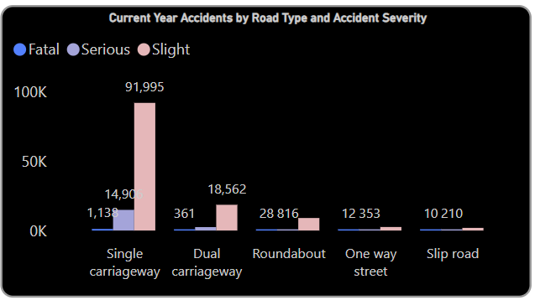

Key Insights
Accident Severity Distribution:
Most accidents in the dataset are classified as "Slight" (low severity).
A significant number of accidents are classified as "Serious," with a much smaller portion being "Fatal."

Slide 9
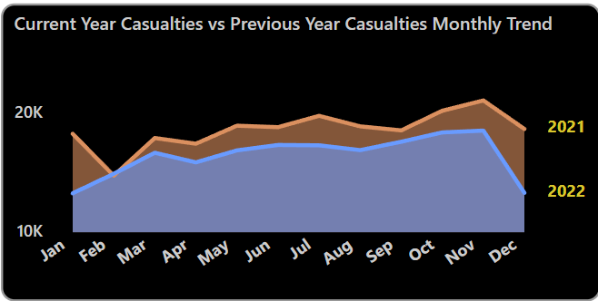
Key Insights
Accident Trends Over Time:
Accidents occurred consistently throughout the year, with occasional spikes and dips in frequency.
Notable fluctuations are seen during certain months, indicating possible external factors (e.g., weather, holidays, or road conditions).
.

Slide 10
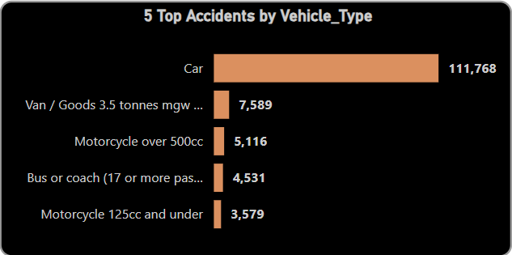
Key Insights
Vehicle Type Analysis:
The bar chart illustrates accident severity based on different vehicle types:
Cars: The majority of accidents involve cars, with most being slight in severity. However, cars also contribute significantly to serious accidents.
Motorcycles: Motorcycles, especially those over 500cc, have a higher proportion of serious and fatal accidents, despite being involved in fewer accidents overall.
Taxis/Private Hire Cars: These vehicles are involved in a moderate number of accidents, most of which are slight.
Heavy Goods Vehicles (HGVs): Although involved in fewer accidents, HGVs have a relatively higher proportion of serious accidents

Slide 11
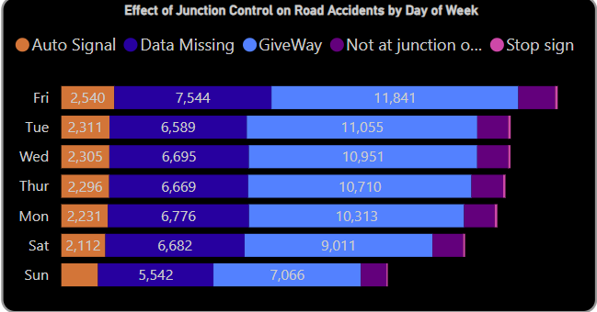
Key Insights
Effect of Junction Control on Road Accidents by Day of Week:
The bar chart illustrates the distribution of accidents across different junction controls throughout the day:
Give Way Traffic Signals: These junctions experience the highest number of accidents, particularly during peak traffic hours (around 8 AM and 5-6 PM).
Auto Signal: Accidents at these junctions are more evenly spread throughout the day, but there are notable peaks during morning and afternoon rush hours.
Other Junction Controls: Stop signs and authorized persons are involved in fewer accidents, and these tend to occur sporadically throughout the day.

Slide 12
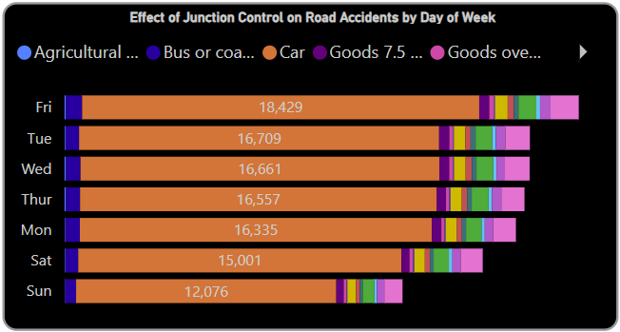
Key Insights
Accidents by Day of the Week and Vehicle Type:
The bar chart provides a breakdown of accidents by day of the week and vehicle type:
Highest Accident Rate:
Friday has the highest number of accidents, with cars being the most involved vehicle type. This could be attributed to higher traffic volumes as people travel for weekend plans or return from work.
Monday also sees a high accident rate, likely due to the start of the workweek, with many cars and taxis involved.
Lowest Accident Rate:
Sunday has the lowest number of accidents across most vehicle types, possibly because of reduced traffic volumes on this day.
Vehicle Type Involvement:
Cars are involved in the majority of accidents throughout the week, with a noticeable peak on Fridays.
Motorcycles show relatively fewer accidents, but they have consistent involvement across the week, with a slight increase on weekends.

Slide 13
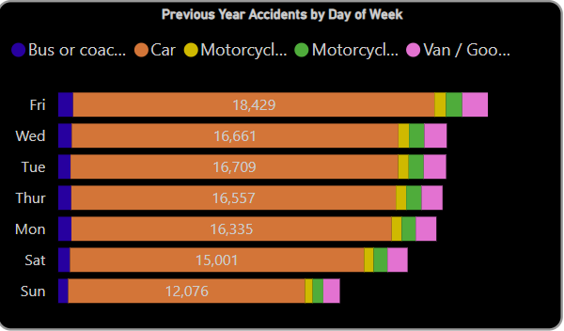
Key Insights
Accidents by Day of the Week and Vehicle Type
Finding:
Fridays and Mondays see the highest number of accidents, while Sundays have the fewest.
Cars are the most involved vehicles across all days, but motorcycles show an increase in accidents over the weekend.
Recommendation:
Implement targeted road safety campaigns on Fridays and Mondays to reduce traffic-related accidents.
Focus on motorcycle safety over the weekends, especially in areas with heavy recreational or long-distance travel.
.

Slide 14
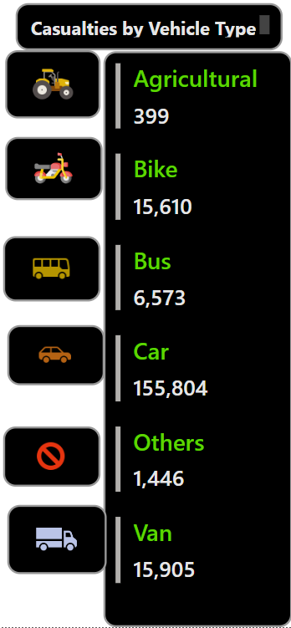
Key Insights
Accident Severity by Vehicle Type
Finding:
Cars are involved in the most accidents, but motorcycles—especially larger ones (500cc and above)—are involved in a higher proportion of serious and fatal accidents relative to their involvement.
Recommendation:
Implement stricter motorcycle safety regulations and awareness programs, particularly for larger vehicles.
Target safety campaigns at car drivers, especially during peak travel times.

Slide 15
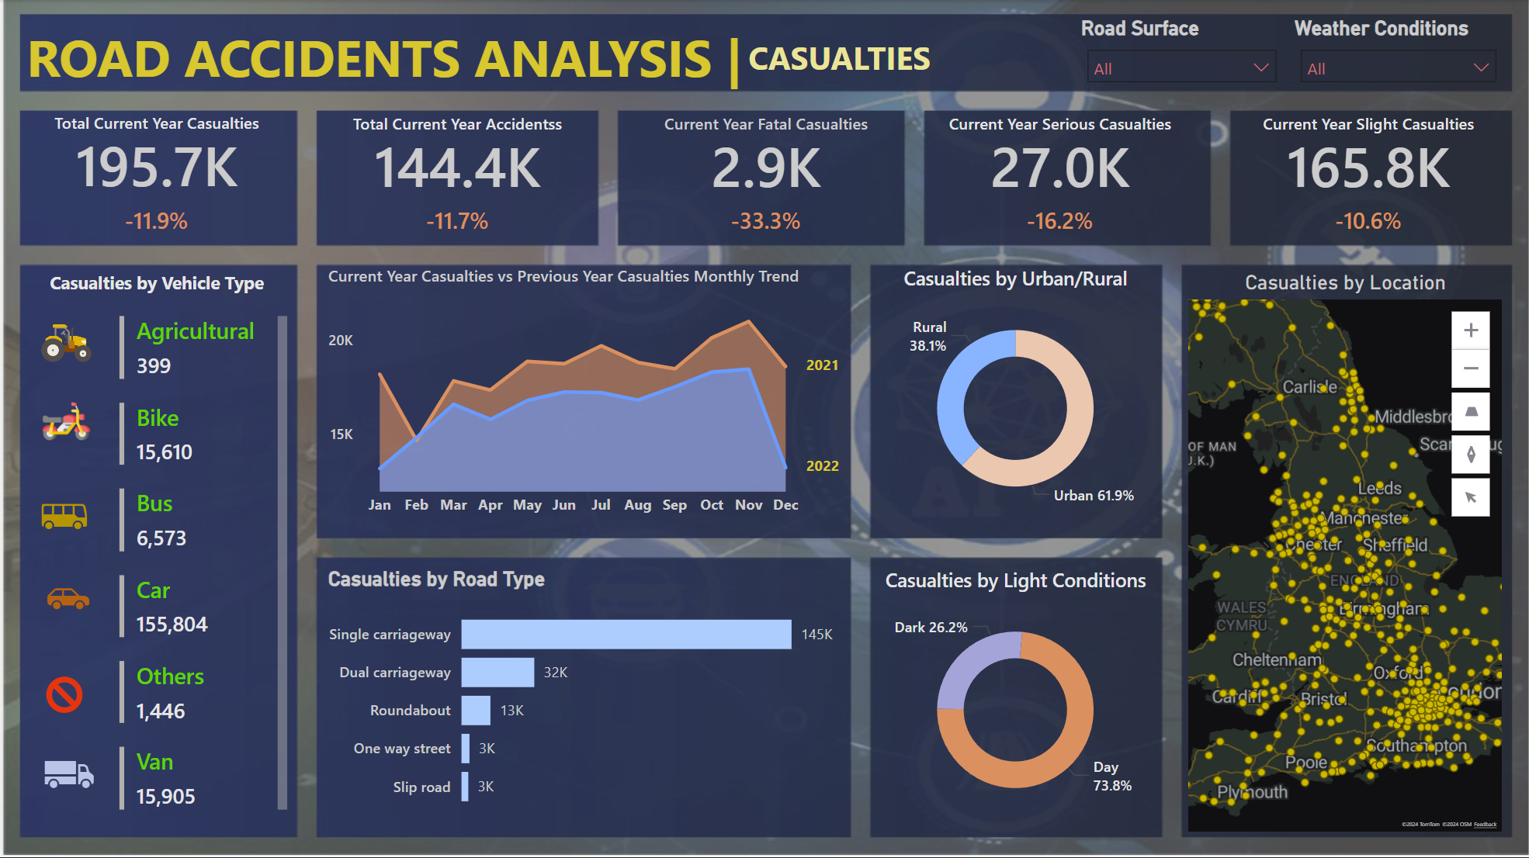
Dashboard snapshot

Slide 16
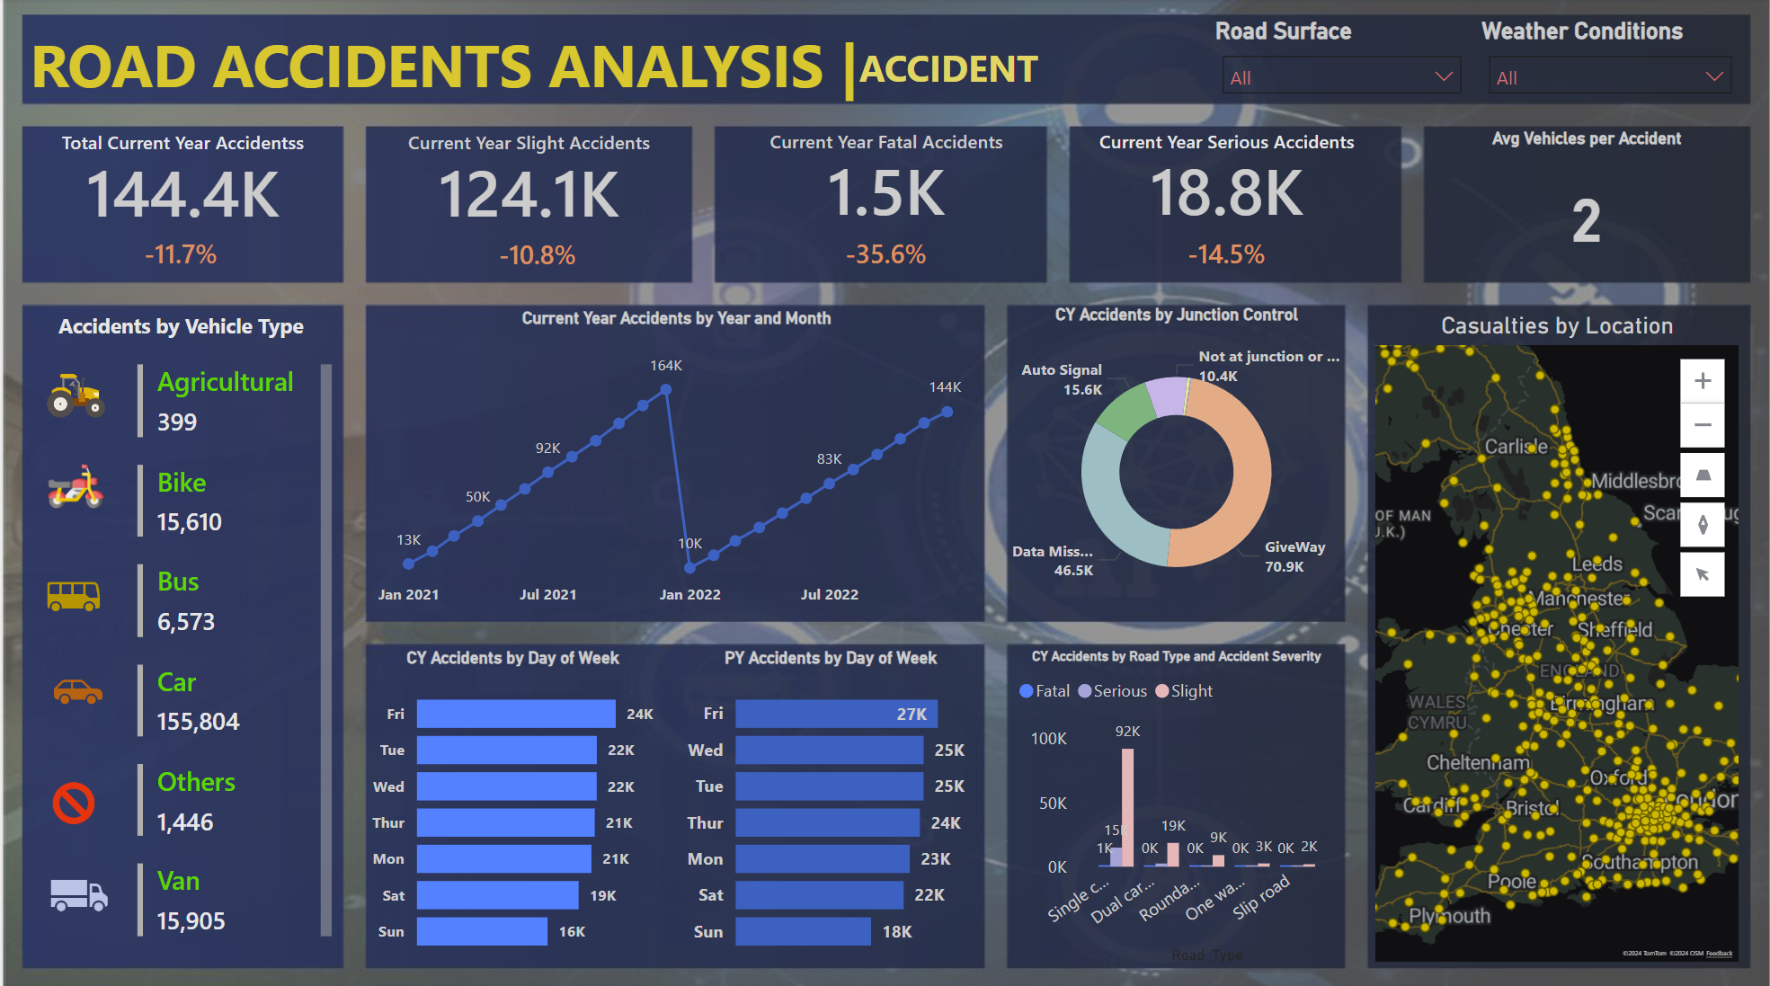
Dashboard snapshot

Slide 17

1. Road Safety During Peak Hours: Enhance traffic signal control and optimize rush hour traffic management. 2. Weather-Related Safety Measures: Introduce stricter speed limits and more robust road safety infrastructure (e.g., signage, lighting, and road maintenance) in adverse weather conditions. 3. Motorcycle Safety: Launch awareness programs and safety campaigns targeted at motorcyclists, particularly for high-powered motorcycles. 4. Improve Safety at Junctions: Focus on improving junction safety by upgrading uncontrolled junctions and optimizing traffic signal timings in high-traffic areas. 5. Targeted Safety Campaigns: Fridays and Mondays are critical days for implementing road safety campaigns and law enforcement efforts, particularly for car drivers.
Key Recommendations

Slide 18
1. Consider enhanced safety measures for 30 mph zones due to the high volume of accidents, even though most are slight. 2. For higher speed zones, focus on reducing serious and fatal accidents through better road design, signage, and speed enforcement. 3. Motorcycle Safety: Implement stricter safety measures for motorcyclists, especially those with larger vehicles, to reduce the risk of serious accidents. 4. Road Safety during Adverse Weather: Enhance warning systems and impose stricter speed limits during rain, fog, and snow to prevent serious accidents. 5. Improve Traffic Signal Safety: Enhance traffic light management during peak hours to reduce accidents at busy junctions, possibly by optimizing light timing or installing warning systems. 6. Uncontrolled Junctions: Consider additional signage or even converting uncontrolled junctions into controlled ones to reduce accidents, especially during high-traffic periods. 7. Implement targeted road safety campaigns on Fridays and Mondays to reduce traffic-related accidents. 8. Focus on motorcycle safety over the weekends, especially in areas with heavy recreational or long-distance travel.
Other Recommendations

Slide 19
Professional Development:
Certifications
Diploma in Data Analytics
Google Cybersecurity Certificate
Professional Scrum Master (PSM)
Professional Scrum Product Owner (PSPO)

Slide 20

Thank you
Augustine

